Slide 1





IMAGINE THIS..
Notes:
Imagine you download what looks like a normal banking or loan app.
You enter your personal details, maybe even your bank information.
Everything seems fine…
But in reality, the app is silently taking control of your phone —
clicking buttons, approving transactions, and transferring money…
without you even touching your screen.

Slide 2


Gigabud Banking Malware Campaign
PRESENTED BY CHAVI, DHEERAJ
PRESENTATION DATE: 2026-04-17

Slide 3

Gigabud Banking Malware Campaign
→ TARGETS ANDROID MOBILE BANKING USERS
→ Observed in regions like Thailand, Philippines, and Peru
→ FOCUSES ON USERS RELYING HEAVILY ON MOBILE FINANCIAL APPS
Notes:
Gigabud.RAT is an Android banking trojan first investigated by Group-IB after targeting customers of a Thailand-based financial organization in 2022.
It spreads through phishing websites and smishing links sent via SMS, instant messengers, and social media.
Group-IB detected more than 400 Gigabud.RAT samples between 2022 and 2023, showing that the malware family was active and widespread.
The malware tricks victims into granting permissions such as app installation, accessibility service, screen recording, and display over other apps.
After permission is granted, it can use screen capture, TouchAction remote gestures, and keylogging to steal credentials, bypass authentication including 2FA, and support fraudulent payments from the victim’s device.

Slide 4
How Victims Get Pulled In
STEP 1:
SMISHING
STEP 2: PHISHING SITE
STEP 3:
APK DELIVERY
STEP 4: PERMISSION SETUP
STEP 5:
OVERLAY + CREDENTIAL & OTP INTERCEPTION
STEP 6:
FRAUD EXECUTION
Notes:
STEP 1: SMISHING
Victim receives a fake bank SMS with an urgent message and malicious link.
STEP 2: PHISHING SITE
User is redirected to a realistic-looking banking website to build trust.
STEP 3: APK DELIVERY
User is tricked into downloading a malicious app outside the Play Store.
STEP 4: PERMISSION SETUP
App requests accessibility permissions to gain control over the device.
STEP 5: OVERLAY + CREDENTIAL & OTP INTERCEPTION
Fake screens capture login details while OTPs are intercepted silently.

Slide 5
DEMO TIME

Slide 6

Meet Alice, a regular banking user

Slide 7
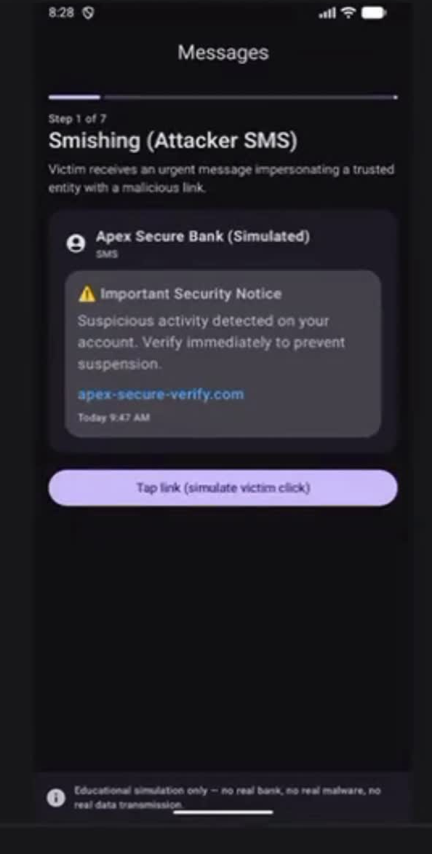
Notes:
Step 1 — SMS
👉 (Show SMS)
“alice receives a message from what appears to be her bank, warning her about suspicious activity.”
“Concerned about her account, she decides to click the link.”
👉 Click
🌐 Step 2 — Landing Page
“alice is redirected to a website that looks legitimate and secure.”
“Trusting the message, she follows the instructions to verify his account.”
👉 Click Download
📥 Step 3 — APK Installation
“alice is asked to install a security app.
Since the message seemed urgent, she enables installation from unknown sources.”
👉 Click
⚙️ Step 4 — Accessibility
“The app now asks for accessibility permissions.
alice assumes this is part of the verification process and grants access.”
👉 Click
🔐 Step 5 — Overlay
“Now alice sees a login screen and enters his credentials, believing it is his bank.”
👉 Click Continue
🔢 Step 6 — OTP
“alice receives an OTP and enters it, unaware that the malware has already captured it.”
👉 Click
🖥 Step 7 — C2
“At this point, the attacker now has full access to alice’s banking session.”
📊 Final Screen
“alice never realized he was being attacked.
From his perspective, everything looked normal.”

Slide 8
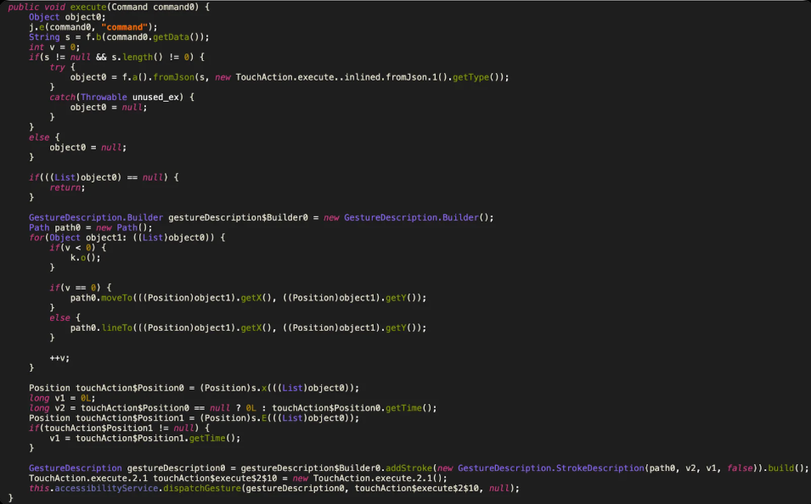
TouchAction Service
  READS COMMAND DATA
  PARSES TOUCH COORDINATES
  STOPS IF DATA IS INVALID
  BUILDS GESTURE PATH
  EXECUTES GESTURE ON DEVICE
Notes:
1. This line reads the incoming command data. In simple terms, the malware first receives the attacker’s instructions before it can simulate any touch action.
2. Here, the malware converts that command data from JSON into a list of touch points. So the attacker’s instructions are turned into coordinates the malware can actually use.”
3. This is a validation step. If the coordinate list is missing or invalid, the function stops, so the gesture will not be executed.”
4. These lines define the actual touch movement. moveTo sets the starting point, and lineTo adds the next points, which lets the malware create a swipe or drag path on the screen.”
5. This is the most important line. It sends the gesture through the Android accessibility service, which means the malware can perform actions directly on the victim’s phone.

Slide 9
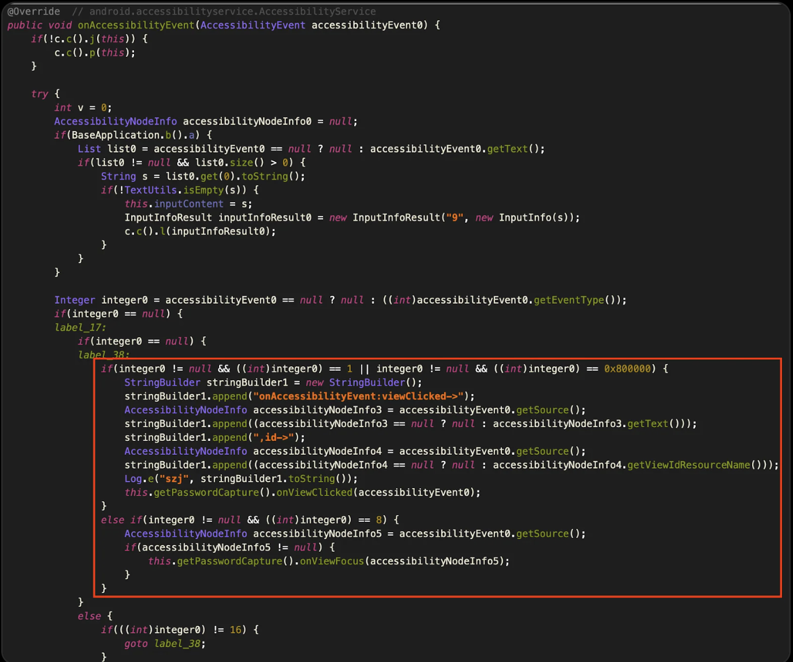
Keylogger implementation
  RECEIVE ACCCESSIBILITY EVENTS
  EXTRACTS VISIBLE INPUT TEXTS
  CHECK EVENTS TYPE
  HANDLES CLICK EVENTS
  MONITORS FOCUSED INPUT FIELDS
Notes:
Figure 9 is the keylogger implementation. In this part of the case study, Group-IB says newer Gigabud samples abuse the Android accessibility service not just for gestures, but also for a password-stealing module aimed at targeted banking apps.
What Figure 9 means
The point of Figure 9 is to show that Gigabud uses accessibility service events to capture what the user types or interacts with inside a banking app. Group-IB says this module is designed for password stealing and appears to be tailored to specific targeted apps rather than acting like a simple generic keylogger.
1. This function is triggered whenever an accessibility event happens on the device. That means the malware can monitor user interaction with the app interface in real time.”
2. This part reads the text associated with the accessibility event. If the user types something or interacts with a text field, the malware can capture that content here.
3. This line checks what kind of UI event occurred. The malware uses this to decide whether the user clicked something, focused on an input field, or triggered another action worth monitoring.
4. When the event is a click, the malware logs details about the clicked element and passes that event to the password-capture module. This helps it track what part of the banking app the user is interacting with.”
5. When an input field gains focus, the malware forwards that node to the password-capture logic. This is important because login fields usually become focused right before the user enters credentials.”

Slide 10
Mitigation Recommendations
OFFICIAL STORES
VERIFY URLS
DEVICE UPDATES
Always download apps from verified sources to reduce the risk of installing malicious software that can compromise your security.
Before entering personal information, ensure that the website URL is correct and secure, avoiding potential phishing scams aimed at stealing your data.
Regularly updating your devices with the latest security patches ensures you have the most robust defenses against emerging malware threats like Gigabud.

Slide 11
Lessons Learned
PHISHING
FAKE APPS
SOCIAL ENGINEERING
Phishing is a common method used to deceive users into providing personal information, often through fraudulent emails or messages.
Cybercriminals create counterfeit applications that mimic legitimate ones to lure users into downloading malware disguised as useful tools.
Attackers exploit human psychology to manipulate users into clicking malicious links or providing sensitive information, increasing the success of their campaigns.

Slide 12
Eternal Blue
CVE-2017-0144
PRESENTED BY MEI TING & DASHINI NAIDU
PRESENTATION DATE: 2026-04-17
Notes:
Good morning, everyone! Today, we’re diving into one of the most notorious cyber exploits: EternalBlue.

Slide 13
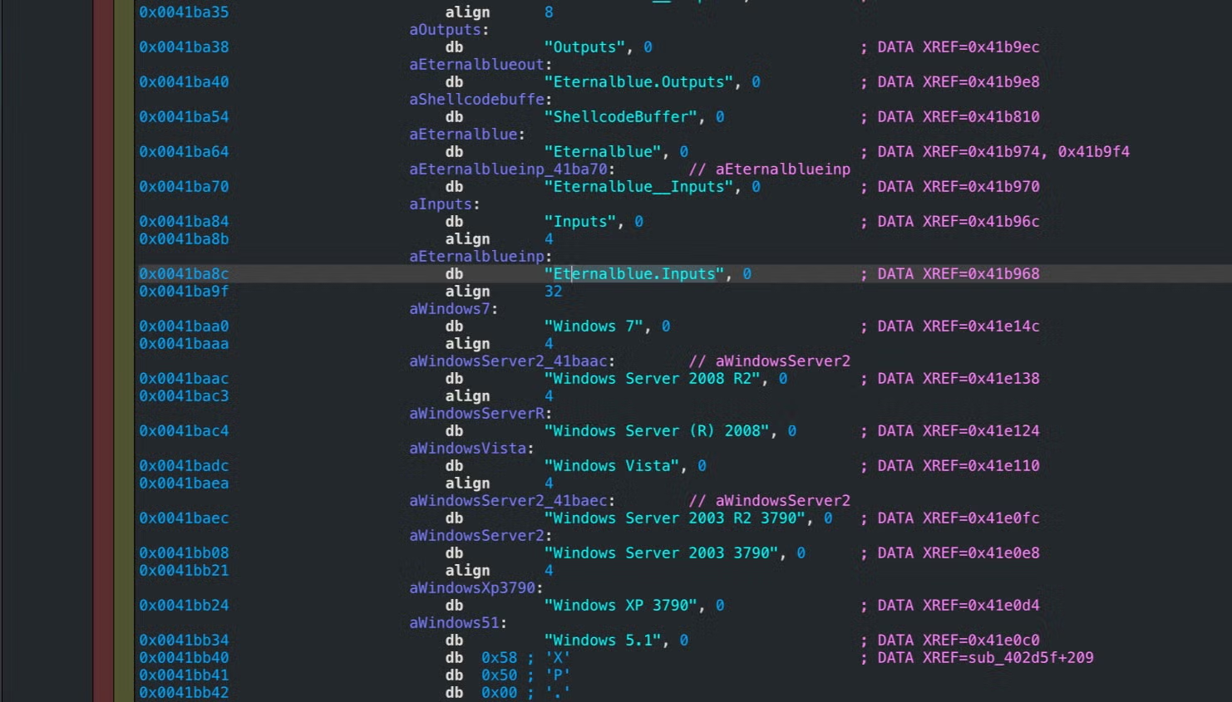
EternalBlue Vulnerability
OVERVIEW
  Exploits vulnerability in Microsoft’s SMBv1 protocol
  Remotely execute malicious code on vulnerable systems
  Don’t need user interactions
  Used in major global cyberattacks (Eg. WannaCry, NotPetya)
Notes:
EternalBlue exploits a critical vulnerability in Microsoft’s SMBv1 protocol that is present in versions like Windows 7, Vista as seen in the picture on the right.
SMBv1, which stands for server message block, is used for file and printer sharing on Windows systems, but it has a serious flaw, one that attackers can exploit to remotely execute code on vulnerable systems, all without needing any user interaction.
It’s infamous for its role in the WannaCry and NotPetya cyberattacks, which caused global chaos. This shows how unpatched systems can lead to widespread cybersecurity crises.
So, how does this thing work? Let’s break it down in 7 simple steps!

Slide 14
Technical Steps
STEP 1: INITIAL CONNECTION
STEP 2: FEA DATA & SETUP
STEP 3: THE CORE BUG
  SMB handshake between attacker and victim
  Establishes communication channel
  Sends large FEA (File Extended Attributes) data
  Fills heap memory
  Prepares for overflow
  OS/2 FEA → NT FEA conversion
  Size miscalculation
  Causes incorrect buffer size
Notes:
Step 1:
The attacker starts by establishing a connection to the victim system’s SMB service over port 445. This connection looks perfectly normal to the system and doesn’t raise any flags, allowing the attacker to stay undetected.
Step 2:
Next, the attacker sends specially crafted FEA (File Extended Attributes) data to the target. This data is used to fill up the heap memory, which prepares for buffer overflow in the next step.
Step 3:
SMB mishandles the size of the FEA data as it incorrectly converts the size from OS/2 format (32-bit) to NT format (16-bit). Due to size miscalculation, it causes less memory to be allocated than expected, resulting in incorrect buffer size.

Slide 15
Technical Steps
STEP 6: TRIGGERING THE OVERFLOW
STEP 4: HEAP SPRAYING
STEP 5: MEMORY GROOMING
  Fill heap with srvnet structures and doublepulsar shellcode
  Srvnet structure contains handler function triggering disconnection.
  Non-paged pool allocation flaw to create a chunk.
  Free it at a controlled time.
  Incoming FEA data reuses freed memory location.
  Increase chance of adjacent srvnet for reliable overflow.
  Final FEA packet sent
  Incorrect calculation the data size
  Overflow occurs
  Overwrite return address of the handler function of on the srvnet structs
Notes:
Step 4: To send and increase the chances of the getting the shellcode to execute, the exploit heap sprays the heap by filling out the heap with srvnet structs and the DoublePulsar shellcode. The svrnet struct will have a handler function that executes on disconnection, we will over flow this later to point to the shellcode which the exploit knows the relative address because it created
the structs.
Step 5: The attacker uses a non-paged pool allocation flaw to create a chunk of a specific size and frees it at a controlled time. This allows the incoming FEA data to reuse that freed memory location. This process is repeated to increase the likelihood that srvnet structures are allocated adjacent to the FEA data, enabling a reliable overflow.
Step 6: We trigger the overflow. We push the FEA data into that hole, and it "spills over" to overwrite the target's instructions.

Slide 16
Technical Steps
STEP 7: EXECUTING OVERWRITTEN POINTER
  All the connections are closed
  Corrupted handler redirects execution to the shellcode.
Notes:
Step 7: Code Execution
When the SMB connection closes, the system runs a cleanup function in srvnet.
Because a function pointer was already changed by the attacker, it now points to the attacker’s code instead of the real system function.
https://www.cs.toronto.edu/~arnold/427/18s/427_18S/indepth/EternalBlue/EternalBlue_report.pdf

Slide 17

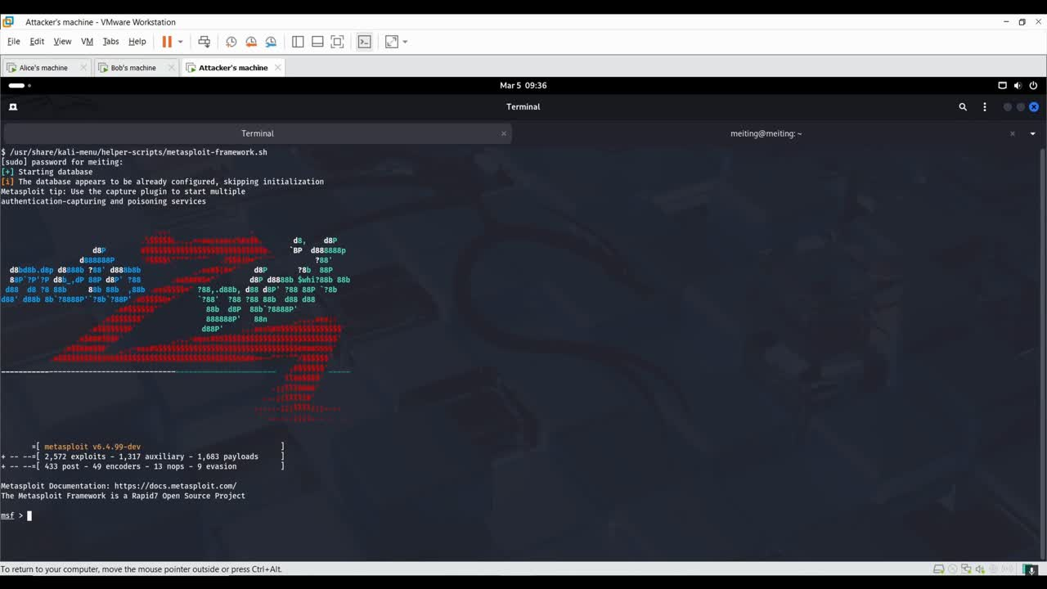
Demo
Notes:
Alright, now let’s make it real. We’re going to show you how an attacker can exploit EternalBlue using Metasploit. There are two parts to this one is reconnaissance and then, we perform attack.
Even before we perform attack, we need to check if th eysstem is vulnerable to so we do that and
Step 1: Select the Exploit Module
We begin by opening Metasploit and selecting the EternalBlue exploit module.
Command: search exploit/windows/smb/ms17_010_eternalblue
Explanation: This module specifically targets the SMBv1 vulnerability and takes advantage of the buffer overflow.
Step 2: Set the Target IP
Now, we need to set the RHOST (Remote Host) to the target machine's IP address.
Command: set RHOST <target_ip>
Explanation: This is the machine we’re going to attack.
Step 3: Choose the Payload
Next, we select the payload. The default is usually windows/x64/meterpreter/reverse_tcp, which gives us a reverse shell on the target machine.
Command: set PAYLOAD windows/x64/meterpreter/reverse_tcp
Step 4: Run the Exploit
Finally, we run the exploit!
Command: run
Explanation: Metasploit sends the payload to the target machine. If successful, we get a reverse shell, meaning we now control the target.
ONCE THE DEMO IS DONE, WE CAN SAY:
See how simple that was? Even someone with no knowledge of hacking can search Google, follow these basic steps, and use Metasploit to take control of a vulnerable system.
Metasploit automates everything, and tools like this make it possible for anyone to exploit SMBv1 vulnerabilities, often without fully understanding the technical details. This is why regular patching and disabling SMBv1 are so crucial for cybersecurity.

Slide 18

Mitigation
MITIGATION STRATEGIES FOR ETERNALBLUE
  Update all systems with latest Microsoft security patches that fix CVE‑2017‑0144
  Disable SMBv1 on all machines
  Conduct regular security audits to check for open ports and other vulnerabilities
Notes:
Some mitigation strategies are:
1. Update all systems with the latest Microsoft security patches, especially those that are still vulnerable to EternalBlue.
2. Turn off SMBv1 completely since it’s outdated and vulnerable.
3. Finally, conduct regular security checks to check for open ports and other vulnerabilities early.

Slide 19


Questions and Discussion

